Slide 1

TEAM - 15
TORONTO WEATHER PREDICTION

Slide 2
OUR TEAM
Qianfang Cheng
Himani.
Erinda Kapllani
Kumud.
Sut Ring Ja K P
Kaushal Ghelani
Bhumika P. Shukla

Slide 3
Table of Contents
Problem Statement
Data Feature Exploration
Data Pre-Processing and Post Processing
Solution
Model Building
Evaluate the Model
Conclusion
Prediction
Data Acquistion
Data Features

Slide 4

ENHANCING HOURLY WEATHER PREDICTION FOR TORONTO USING DEEP LEARNING
Accurate and timely weather forecasts are crucial for a variety of applications, ranging from daily planning to emergency preparedness. In the context of Toronto, where weather conditions can exhibit significant variability, there is a growing demand for precise hourly weather predictions.
This project aims to leverage deep learning techniques to enhance the accuracy of hourly weather forecasts in Toronto, providing valuable insights into short-term meteorological patterns. The successful implementation of a deep learning model for this purpose can contribute to improved decision-making processes and enhance overall community resilience in the face of changing weather conditions.

Slide 5
SOLUTION
Training from Scratch
Customization for Local Patterns: Training the model from scratch allows us to tailor it specifically to the unique weather patterns observed in Toronto. Local nuances, which may not be captured by a pre-trained model, can be learned and utilized for improved accuracy.
Targeted Feature Representation: Toronto's weather can be influenced by various factors, including its geographical location and regional climate. Starting from scratch enables us to carefully select and represent features that are particularly relevant to the local weather dynamics.
Enhanced Model Flexibility: Building the model from the ground up provides greater flexibility in terms of architecture and hyperparameter tuning. This allows us to experiment with different network structures and configurations to find the optimal model for Toronto's hourly weather prediction.
Using Pre-trained Model
Time and Resource Efficiency: Utilizing a pre-trained model can significantly reduce the time and computational resources required for training. This is particularly beneficial when working with limited computing power or tight project timelines.
Transfer Learning Advantages: Pre-trained models, especially those trained on large and diverse datasets, may capture general weather patterns and features that are transferable to Toronto's context. This can expedite the learning process and potentially lead to faster convergence.
Data Efficiency: In scenarios where limited labelled data for Toronto is available, a pre-trained model can leverage knowledge gained from other datasets, acting as a powerful feature extractor. This is particularly advantageous when working with small or scarce datasets.

Slide 6
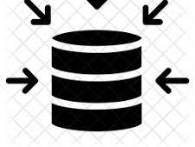
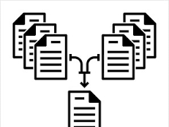
DATA ACQUISITION & PROCESSING
Data Acquisition:
•Sourced from the API offered https://www.visualcrossing.com/
•Format: Hourly-based observations spanning the last 5 years.
Merging Steps:
•Data collection involved obtaining multiple CSV files from the API.
•These files were subsequently appended, concatenated, and organized based on date.

Slide 7
DATA FEATURES
Name
Datetime
Temp
Feelslike
Dew
humidity,
Precip
Precipprob
Preciptype
Snow
Snowdepth
Windgust
Windspeed
Winddir
Sealevelpressure
Cloudcover
Visibility
Solarradiation
Solarenergy
Vvindex
Severerisk
Condition
Station

Slide 8
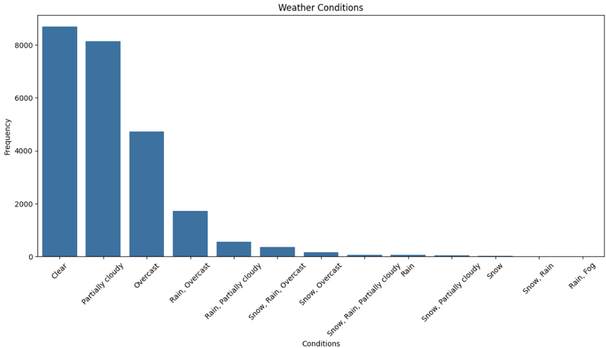
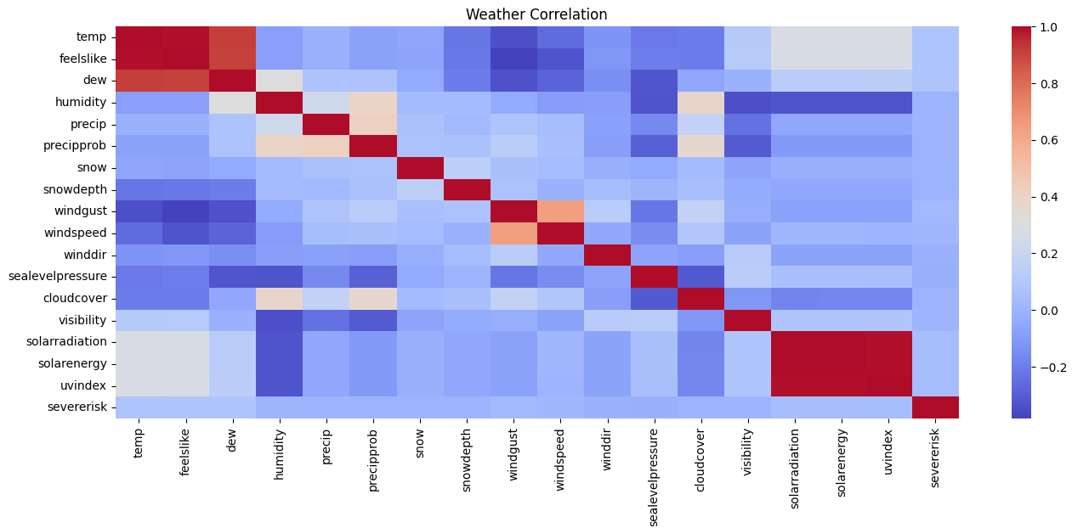
FEATURE EXPLORATION
Overall Weather condition
-From the histogram visualization, the "Clear" weather condition is most frequenctly observed followed by "Partially cloudy".
-Less frequent ('Rain', 'Snow', and 'Fog') are indication of extreme weather conditions
Correlations
-From the heat map, Red squares are indicating positive correlations where blue squares are indicating negative correlation.
-'Temp' and 'Feelslike' are having hight positive correlation.

Slide 9
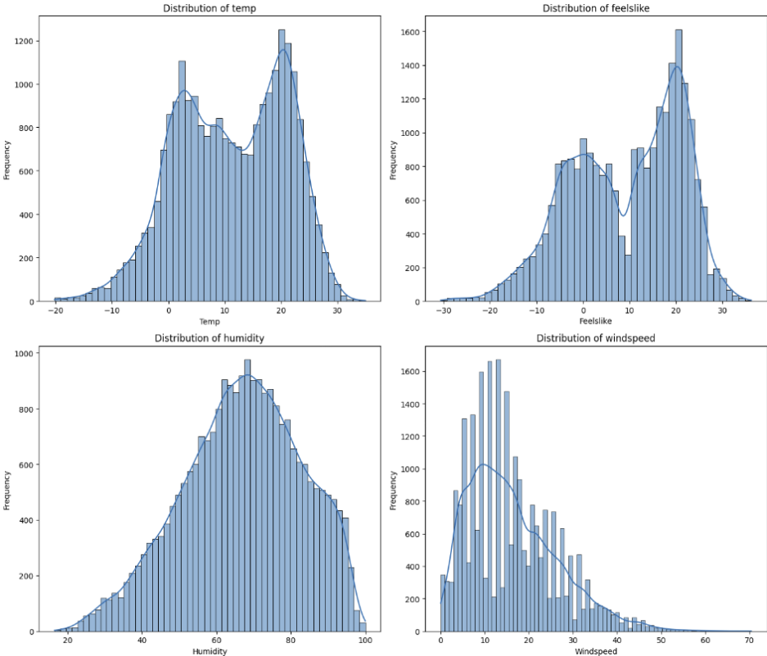
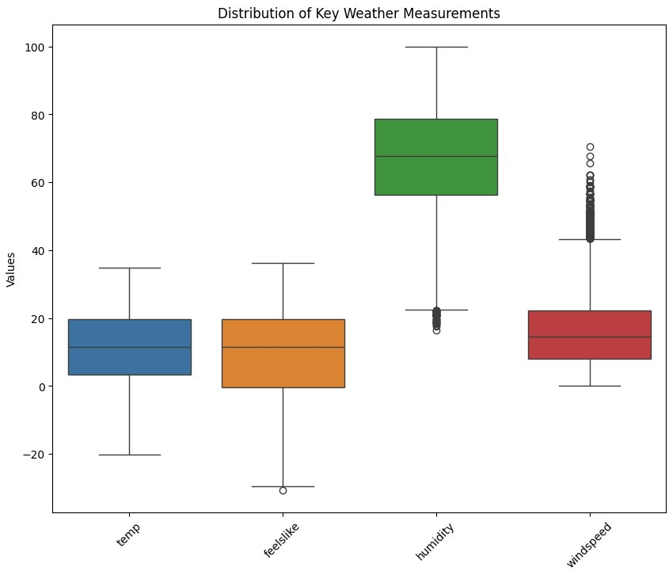
FEATURE EXPLORATION
Distribution Insights
-The double peaks in this distribution means there are two prevalent sets of conditions which are Inflencenced by seasonal changes.
-'wind speed' is indicating that most of the days in Toronto have moderate wind with occasional days have high wind speed.
Box-Plot insights
-"Temperature" and 'feels_like' have a wider range of typical values compared to humidity
-Outliers from "wind_speed" are predicting extreme weather events.

Slide 10
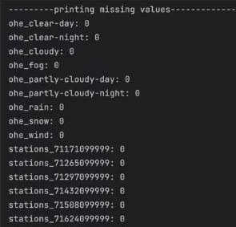
DATA CLEANING
Removing duplicate values:
It involves eliminating identical entries in a dataset, ensuring each unique data point appears only once.
Datetime conversion and sorting:
The datetime column's data type is converted to a datetime object, and the dataset is sorted by date.
Filling NaN values:
These are with the "previous value" involves substituting missing data points with the most recent non-null value in the respective column.
Imputation:
TheColumns preciptype, name, and stations are dropped as preciptype is deemed redundant. Missing values in snow, snowdepth, sealevel pressure, severe risk, visibility, and windgust are imputed.
Handling Missing Values:
MissingValues can indicate data quality issues. They may result from errors in data collection, system failures, or simply incomplete information.
Output showing that our data has no missing values

Slide 11
DATA PRE-PROCESSING & POST- PROCESSING
Pre-Processing:
Convert categorical features to numerical
Create time series features based on datetime
Dropped columns after Correlation Heatmap comparison
Encode Categorical variables
Splitting the data into Train and Test data
Splitting data sequences, using batches, and shuffling the training datasets
Post-Processing:
Reverse split sequences and unscale numerical values .

Slide 12
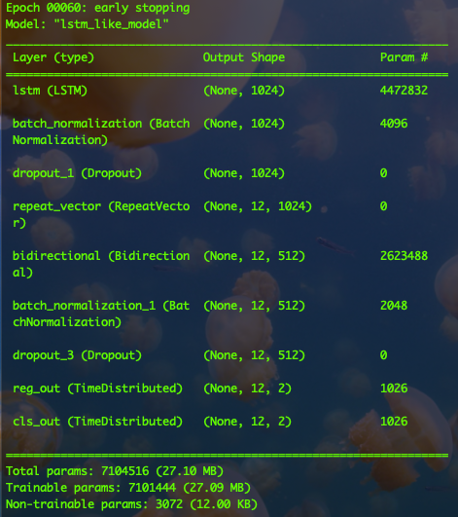
NEURAL NETWORK ARCHITECTURE
RepeatVector Layer: Replicate the input across a specified number of times
TimeDistributed Layer: Handle the temporal nature of the data, capture dependencies across different time steps
Bidirectional LSTM layer: Processes sequences in both forward and backward directions, capturing richer temporal dependencies.
Dropout Layer: To have a better regularization on the model.
BatchNormalization Layer: Improve the training stability and speed, and generalization performance.

Slide 13
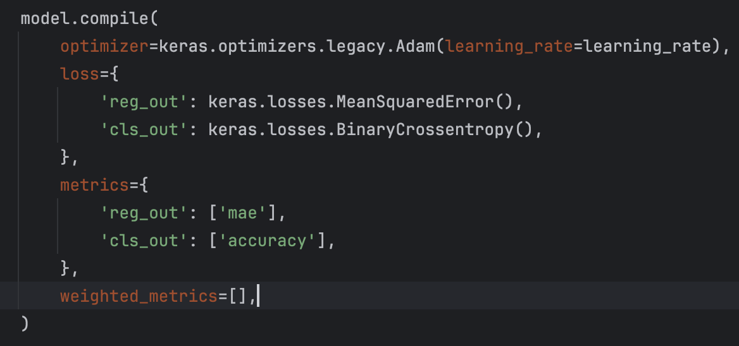
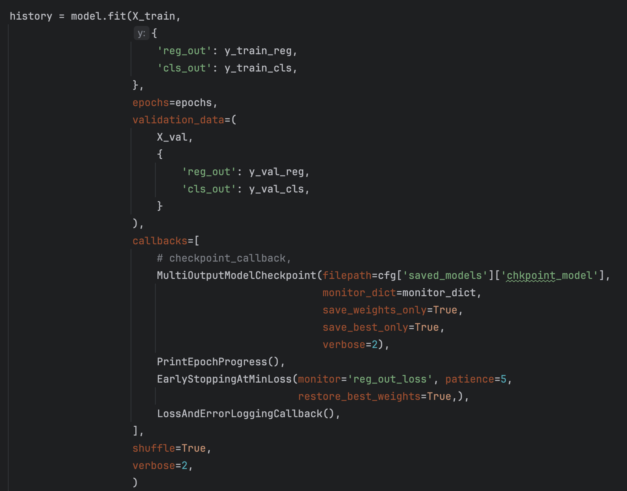
CONFIGURE AND TRAINING OF NEURAL NETWORK MODEL
Evaluate Training and Validation Dataset
Use Adam as the optimizer
Implement MeanSquaredError and BinaryCrossentropy as loss functions for regression and classification tasks respectively
Use MAE and Accuracy as metrics for regression and classification tasks respectively
Use Early stopping to prevent overfitting
Use Learning Curve to access the training process

Slide 14
EVALUATION OF NEURAL NETWORK MODEL
Hyperparameters implemented during model training
N_steps_in | N_steps_out | Train/val/test sizes | Batch_size | Learning Rate
24 * 7 | 24 / 4 | 70% - 15% - 15% | 24 * 90 | 5e-5
Training result
Loss | Cls_out_accuracy | Reg_out_loss | Val_reg_out_loss | Val_cls_out_accuracy
0.3218 | 0.8208 | 0.0081 | 0.8090 | 0.0041
Test evaluation result
Loss | Reg_out_mae | Reg_out_loss | Cls_out_accuracy | Cls_out_loss
0.5448 | 0.0632 | 0.0052 | 0.7390 | 0.1919

Slide 15
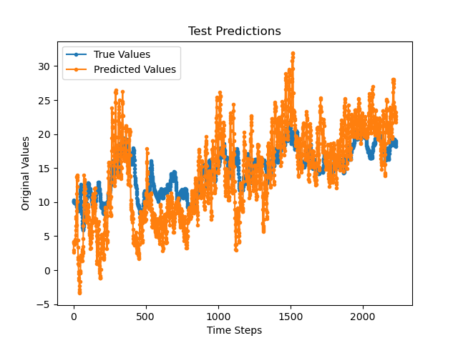
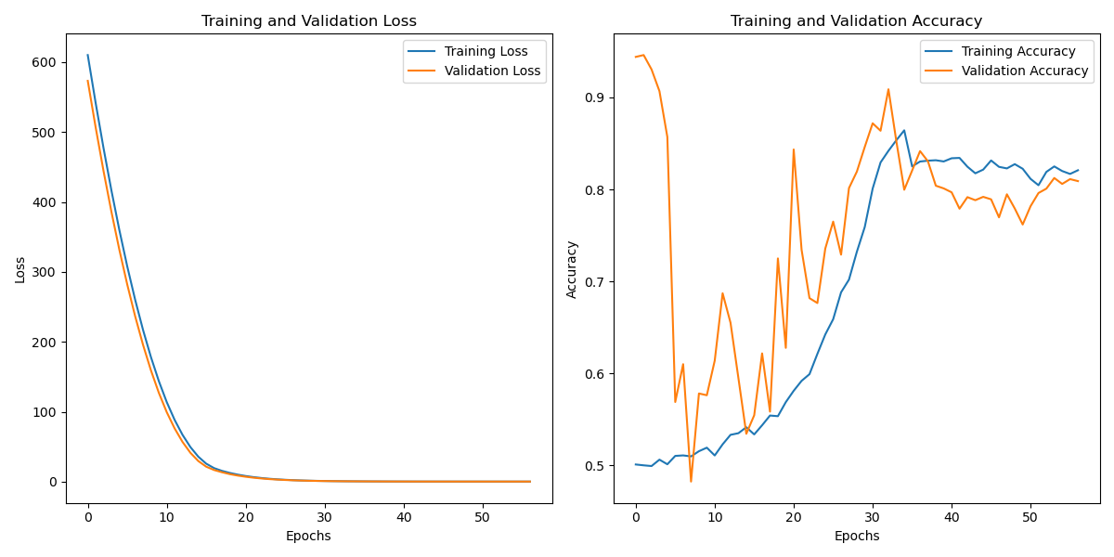
EVALUATE NEURAL NETWORK MODEL
Evaluation result of temp
after inverse transforming data
Learning Curve

Slide 16
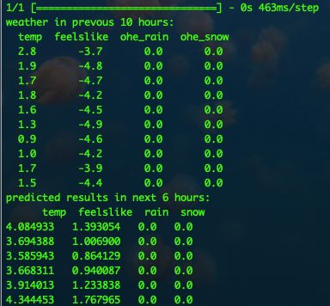
PREDICTION OUTPUT OF NEURAL NETWORK MODEL
- The image displays a terminal output showcasing weather data.
- The first section lists temperatures and "feels like" temperatures for the past 10 hours.
- Additional columns for one-hot encoded (ohe) rain and snow are included, all showing zero, indicating no precipitation.
- The second section presents predicted weather data for the next 6 hours.
- It includes temperatures, "feels like" temperatures, and once more, one-hot encoded rain and snow predictions.
- The forecasts suggest slight changes in temperature and "feels like" readings.
- No precipitation is expected in the next 6 hours according to the predictions.
Terminal output showcasing weather data

Slide 17
CONCLUSION AND NEXT PLAN
Conclusion:
Model may face overfitting issues
High variance in validation accuracy
Model need continuous training to predict update-to-date weather information
Next Plan
Increase model complexity
Address dataset imbalance issues
Do more feature engineering
Add data
Use cross-validation
Adjust regularizations
Fine-tuning hyperparameters

Slide 18

Thank YOU
Questions?

